Slide 1
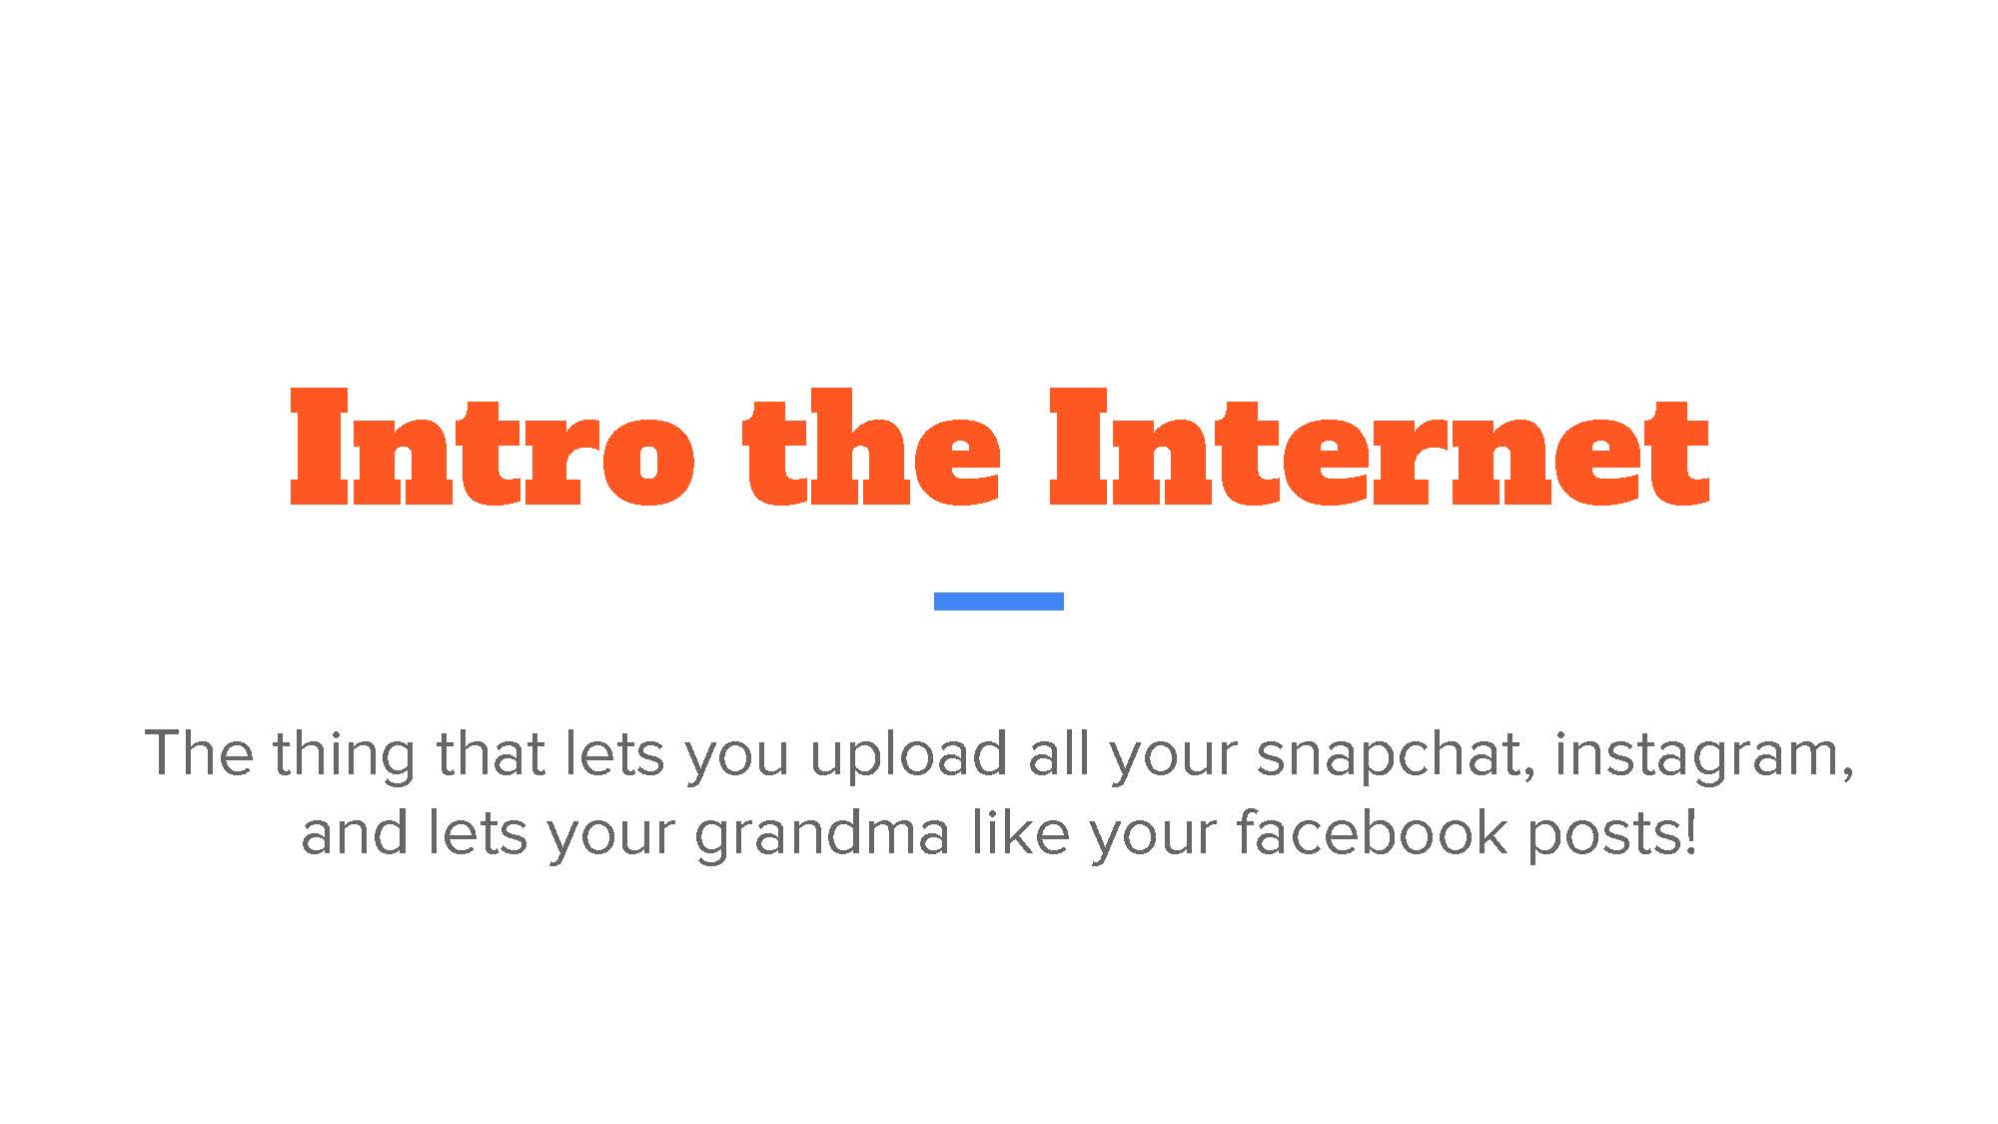

Slide 2


Slide 3
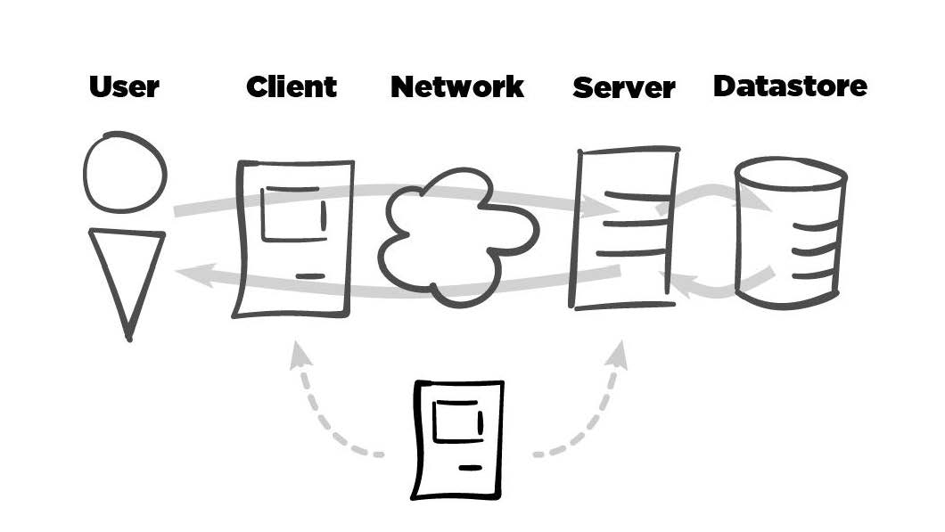

Slide 4


Slide 5


Slide 6
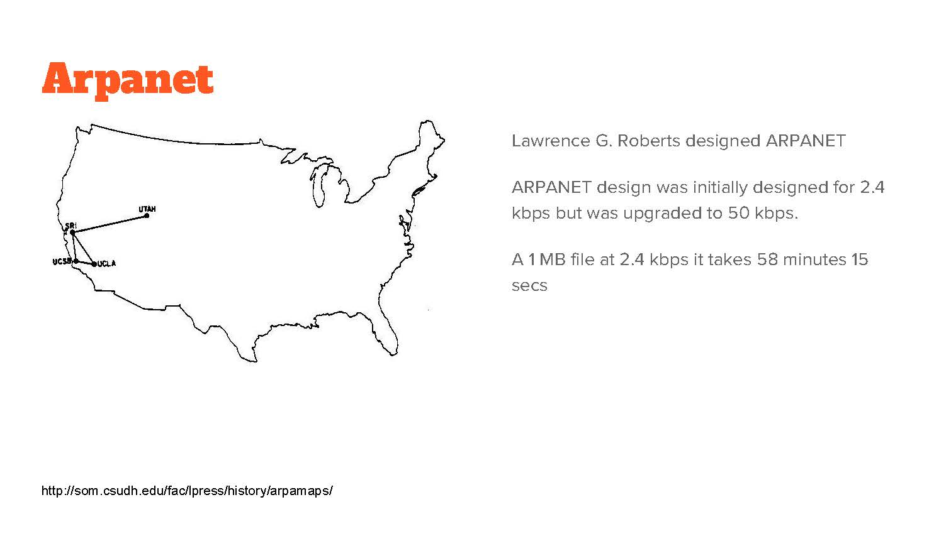

Slide 7
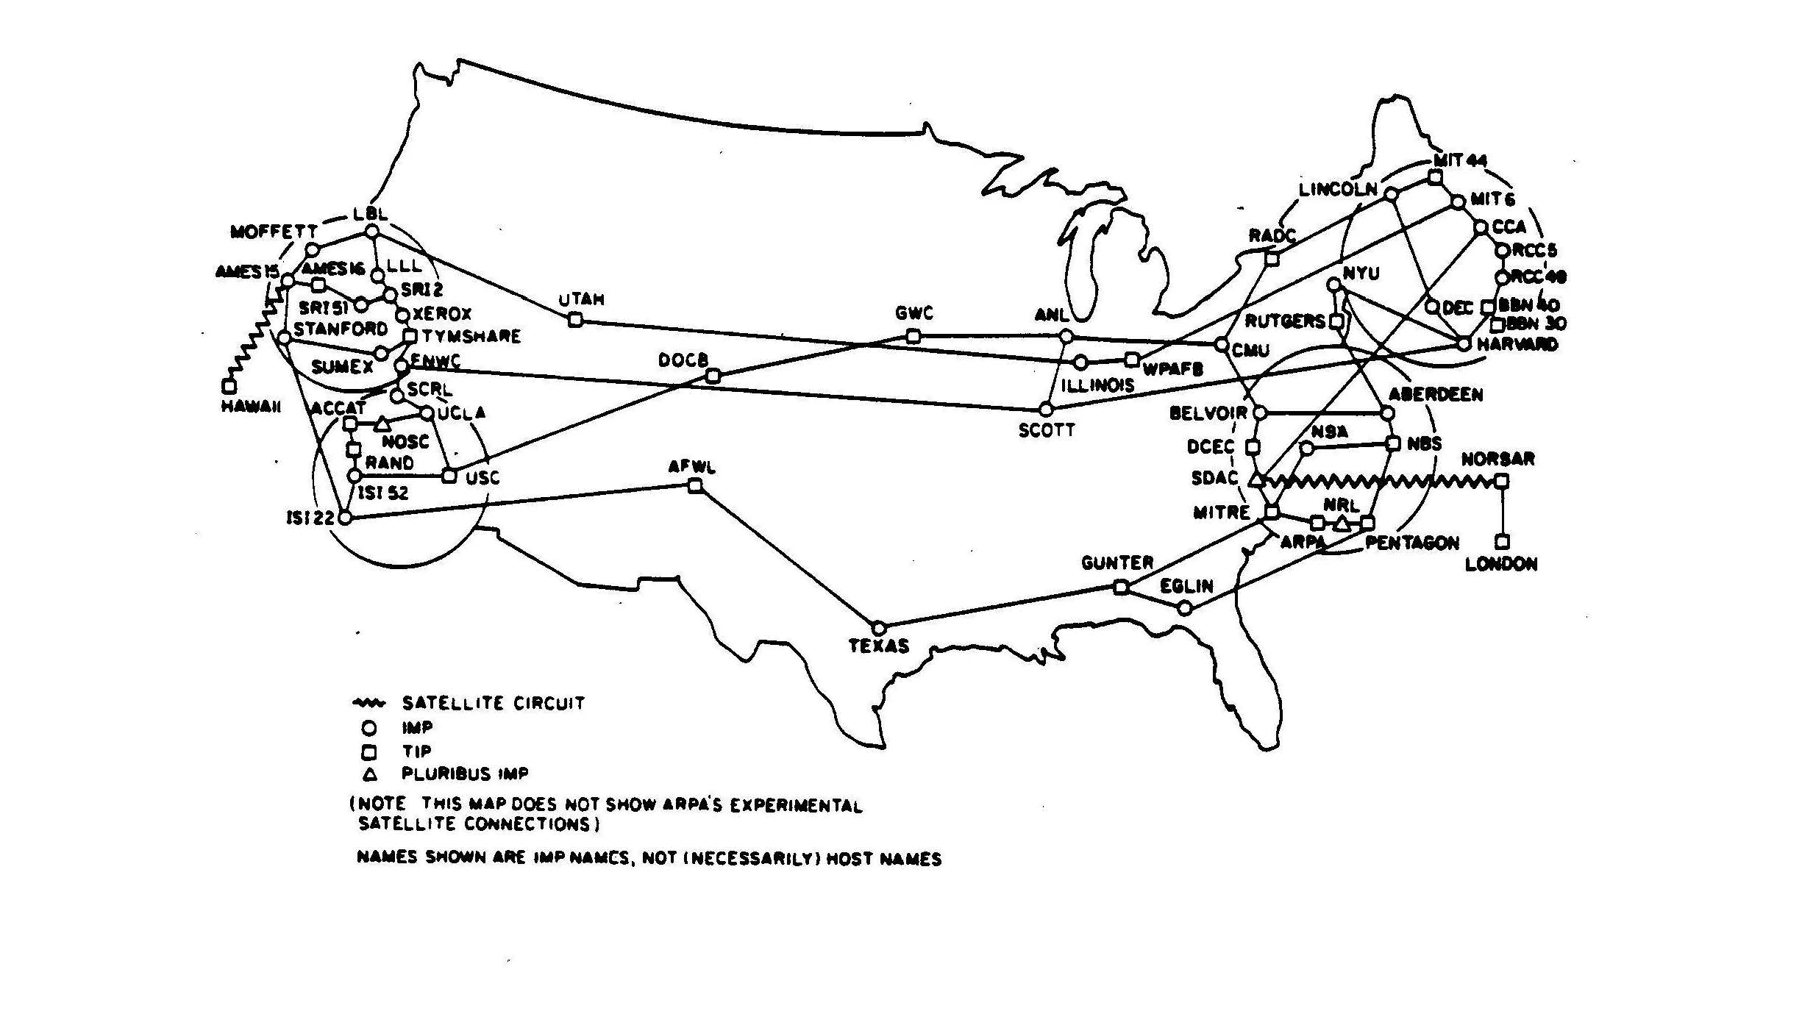

Slide 8
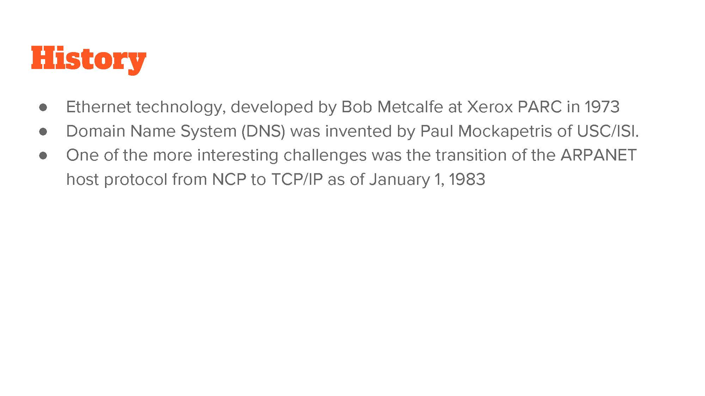

Slide 9
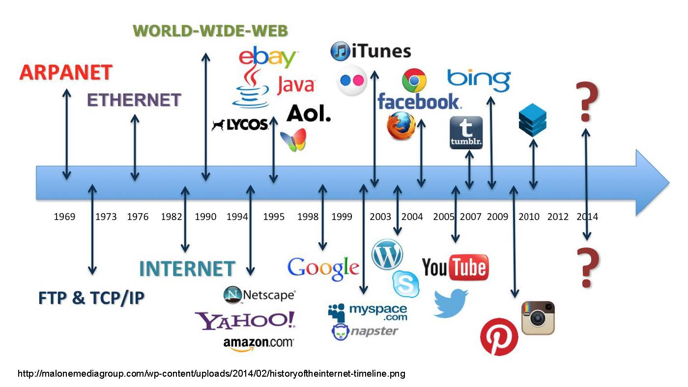

Slide 10


Slide 11
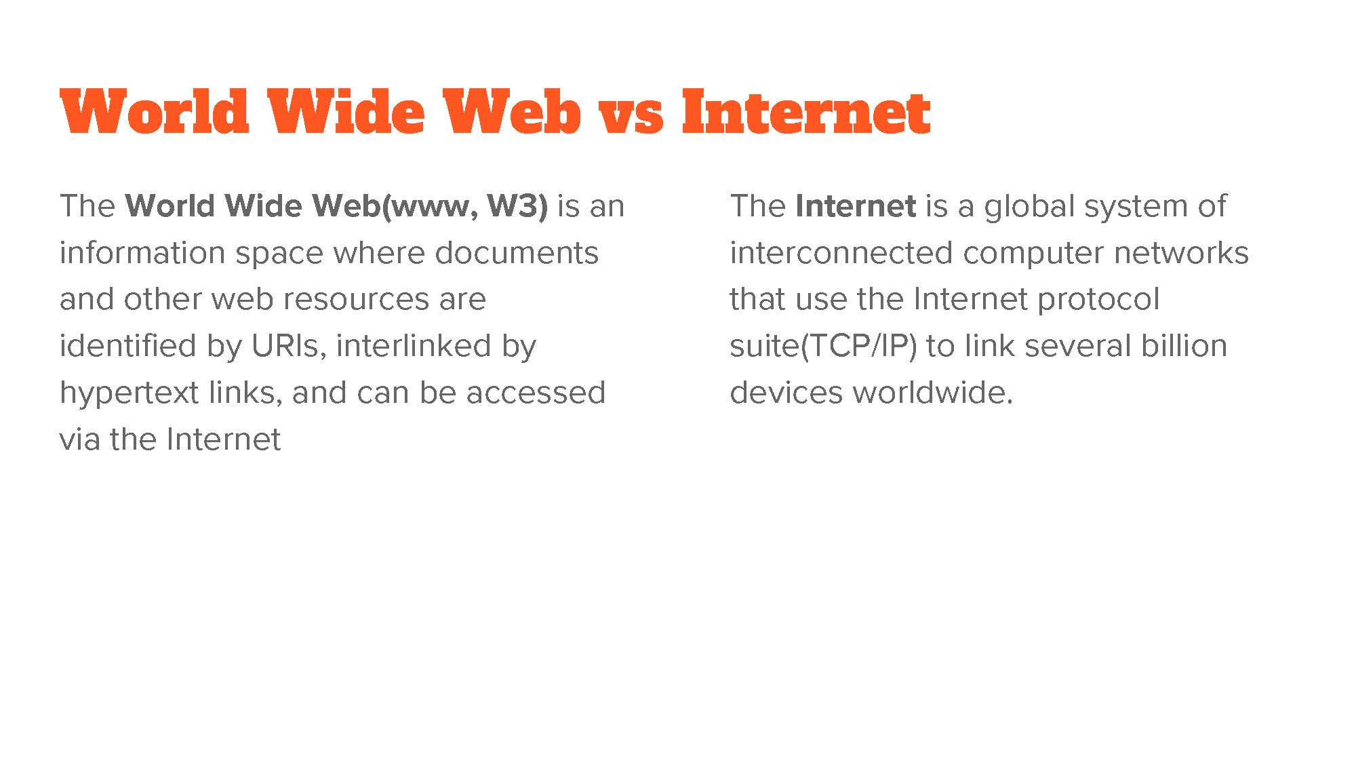

Slide 12


Slide 13


Slide 14
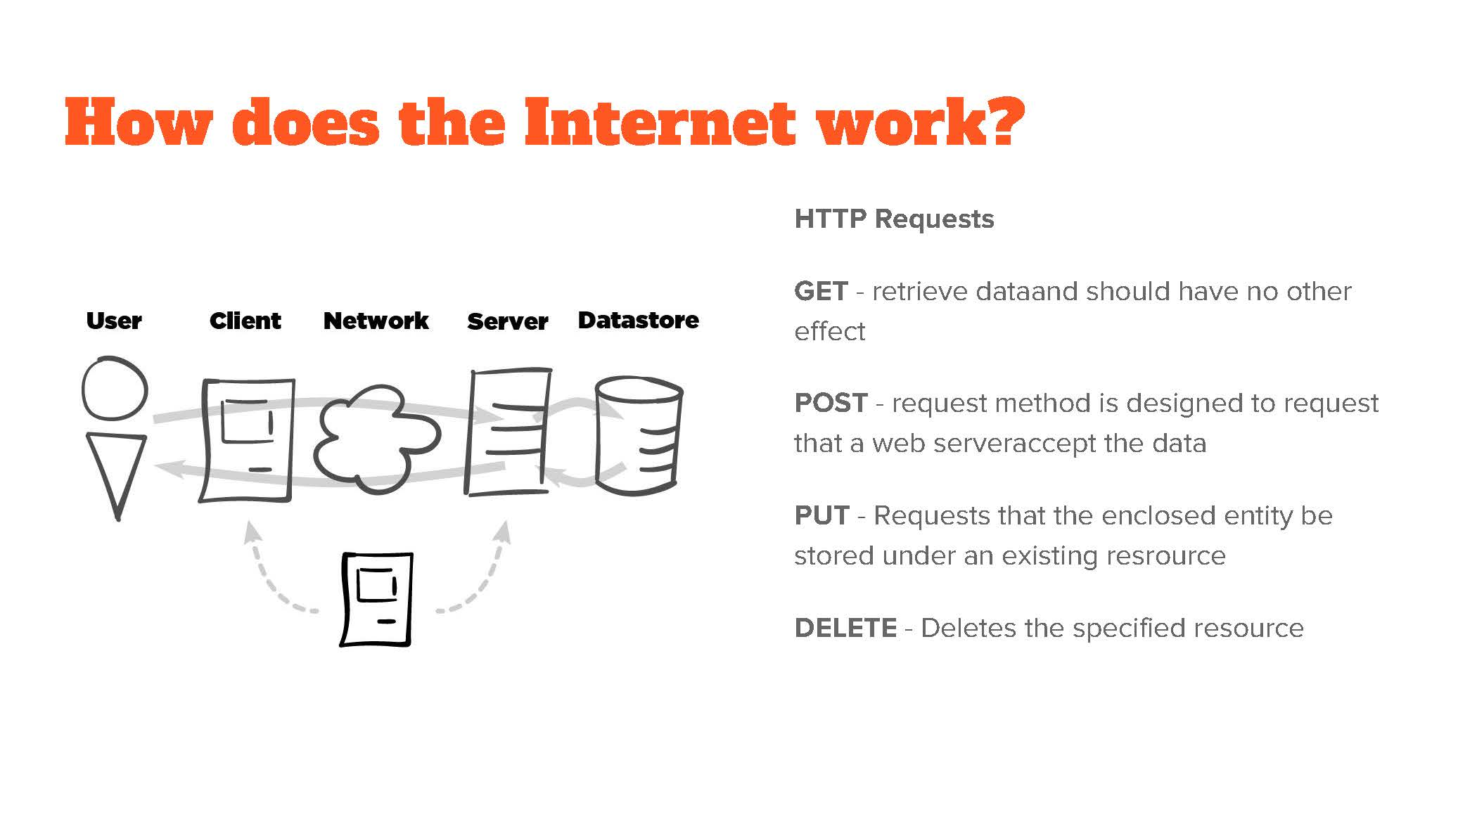

Slide 15
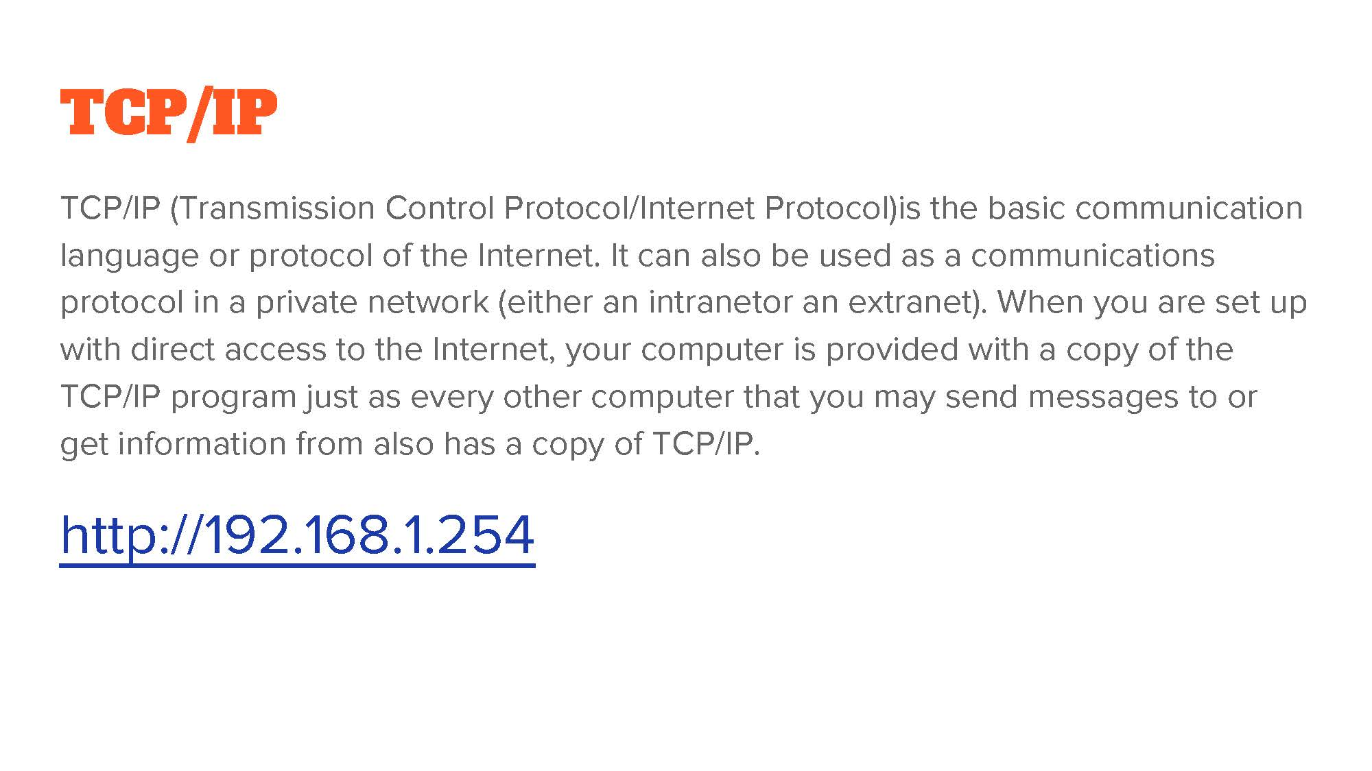

Slide 16
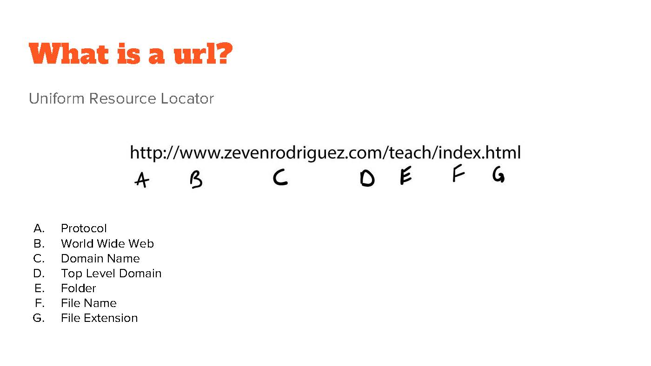

Slide 17


Slide 18
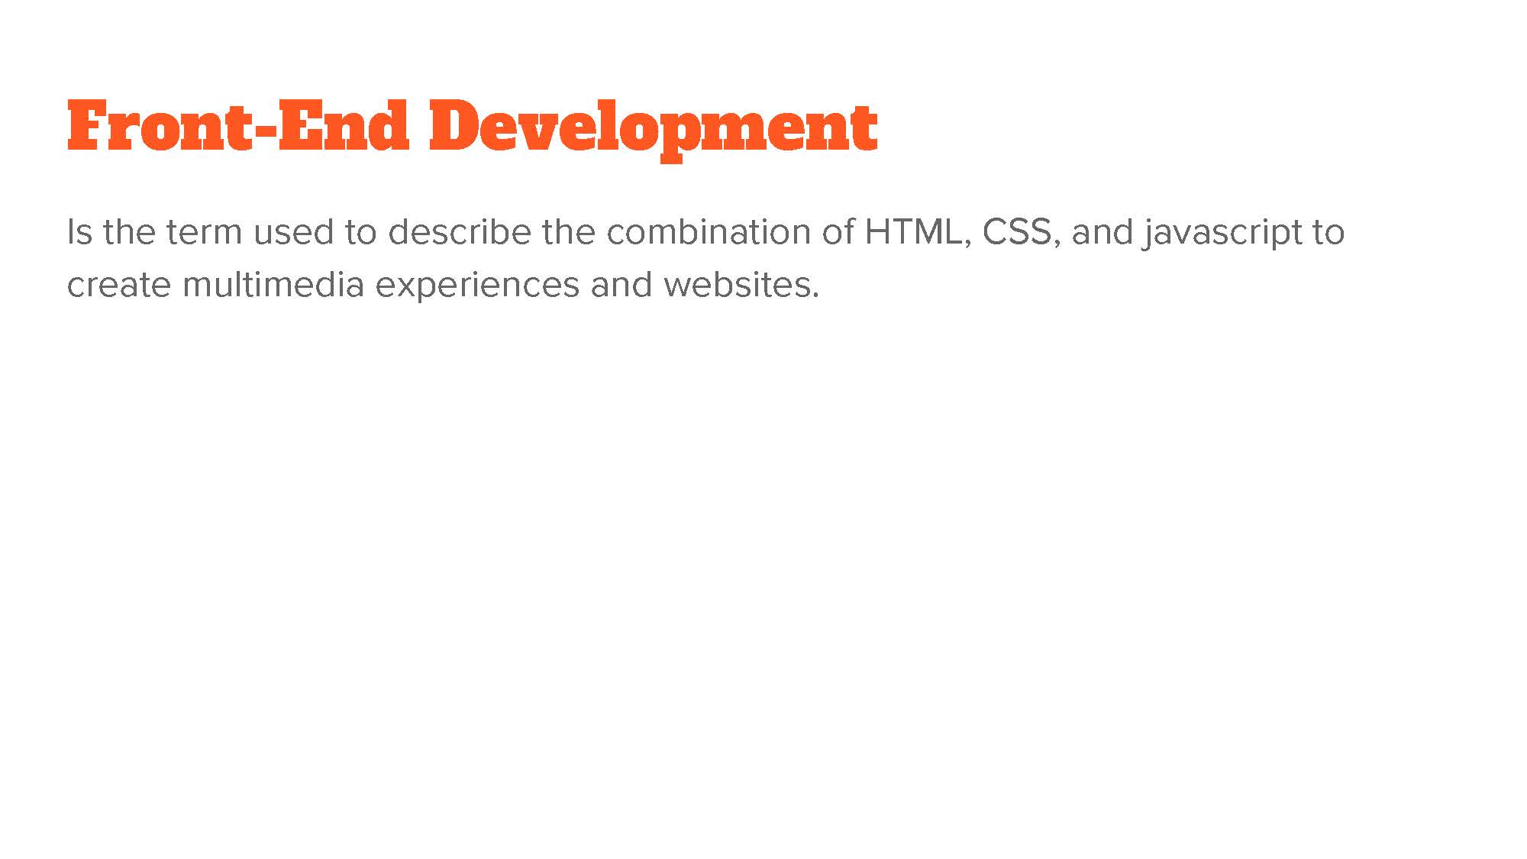

Slide 19
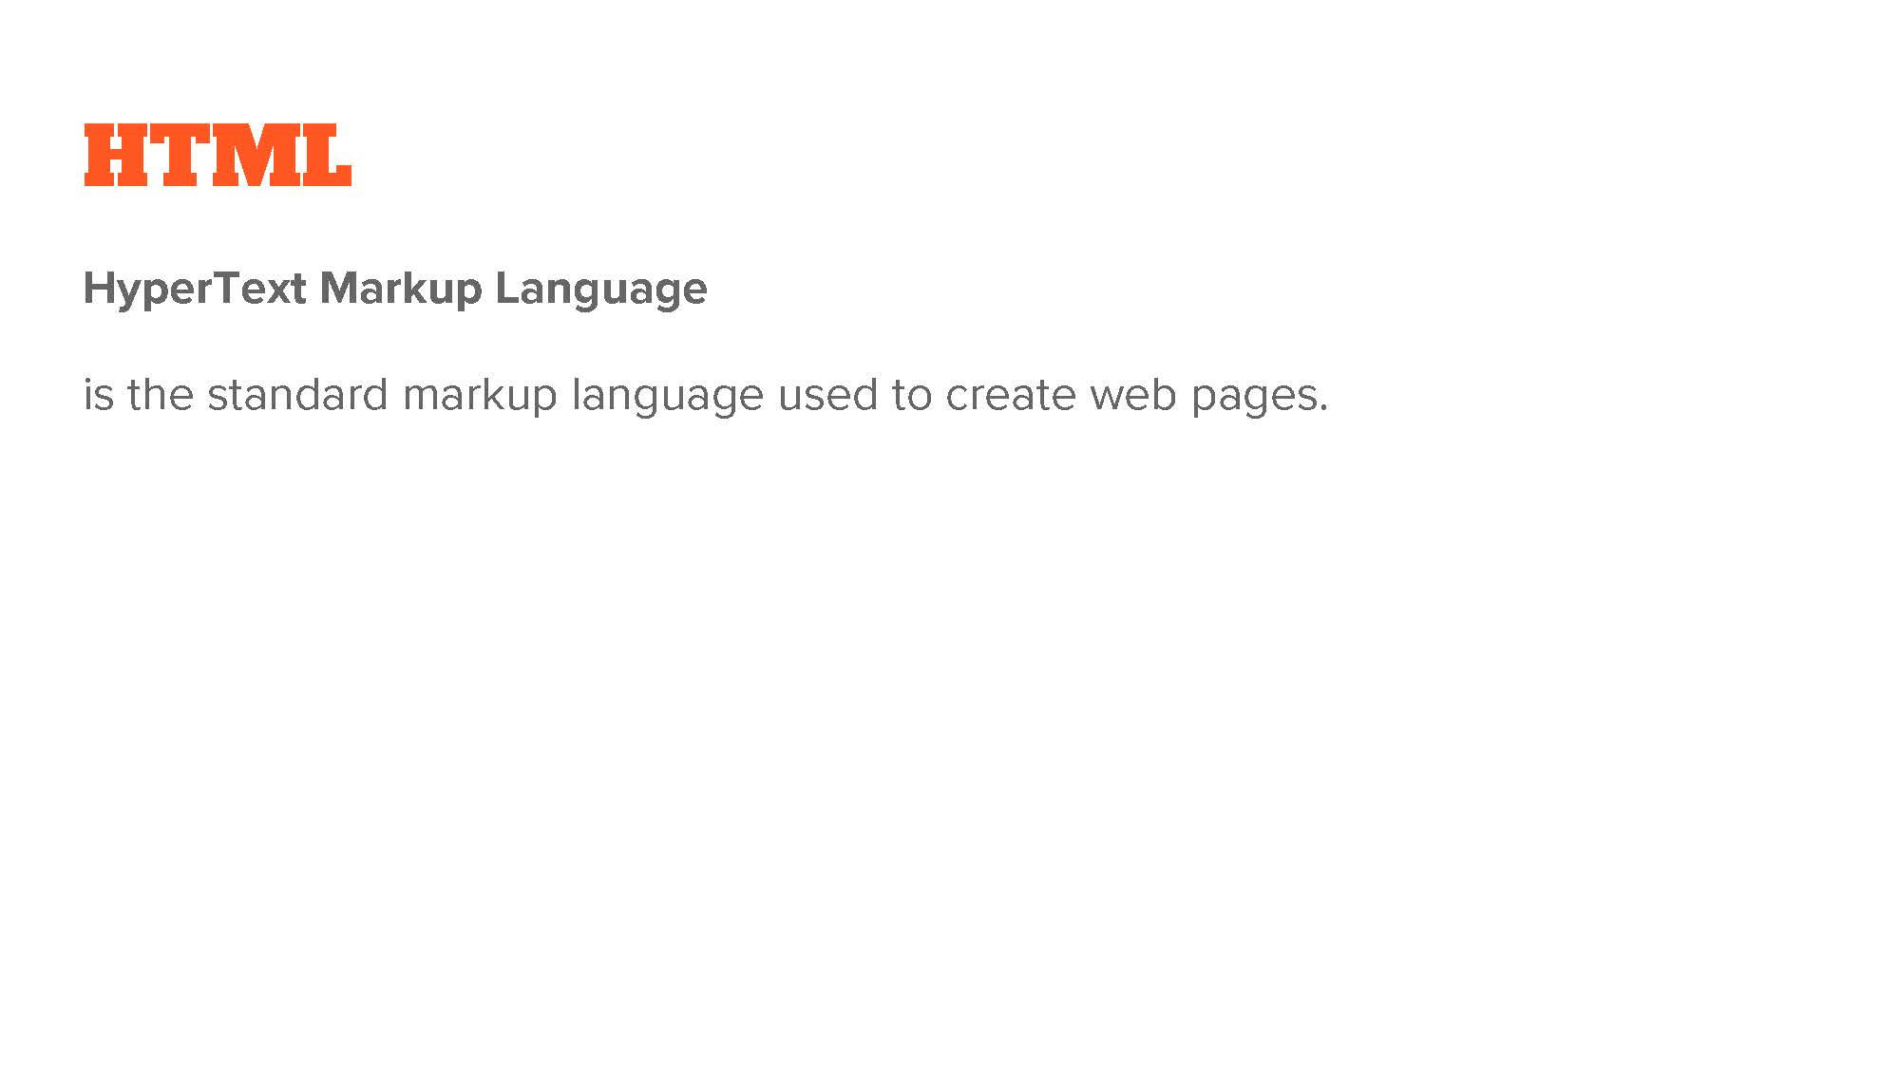

Slide 20
First-Ever Website went live August 6, 1991
Created by: Tim Berners-Lee
Tim is attributed the creator of the first Web Browser and the World Wide Web.
http://info.cern.ch/hypertext/WWW/TheProject.html.

Slide 21


Slide 22
CSS Zen Garden
Demonstrates what can be accomplished through CSS-based design.
http://www.csszengarden.com/

Slide 23
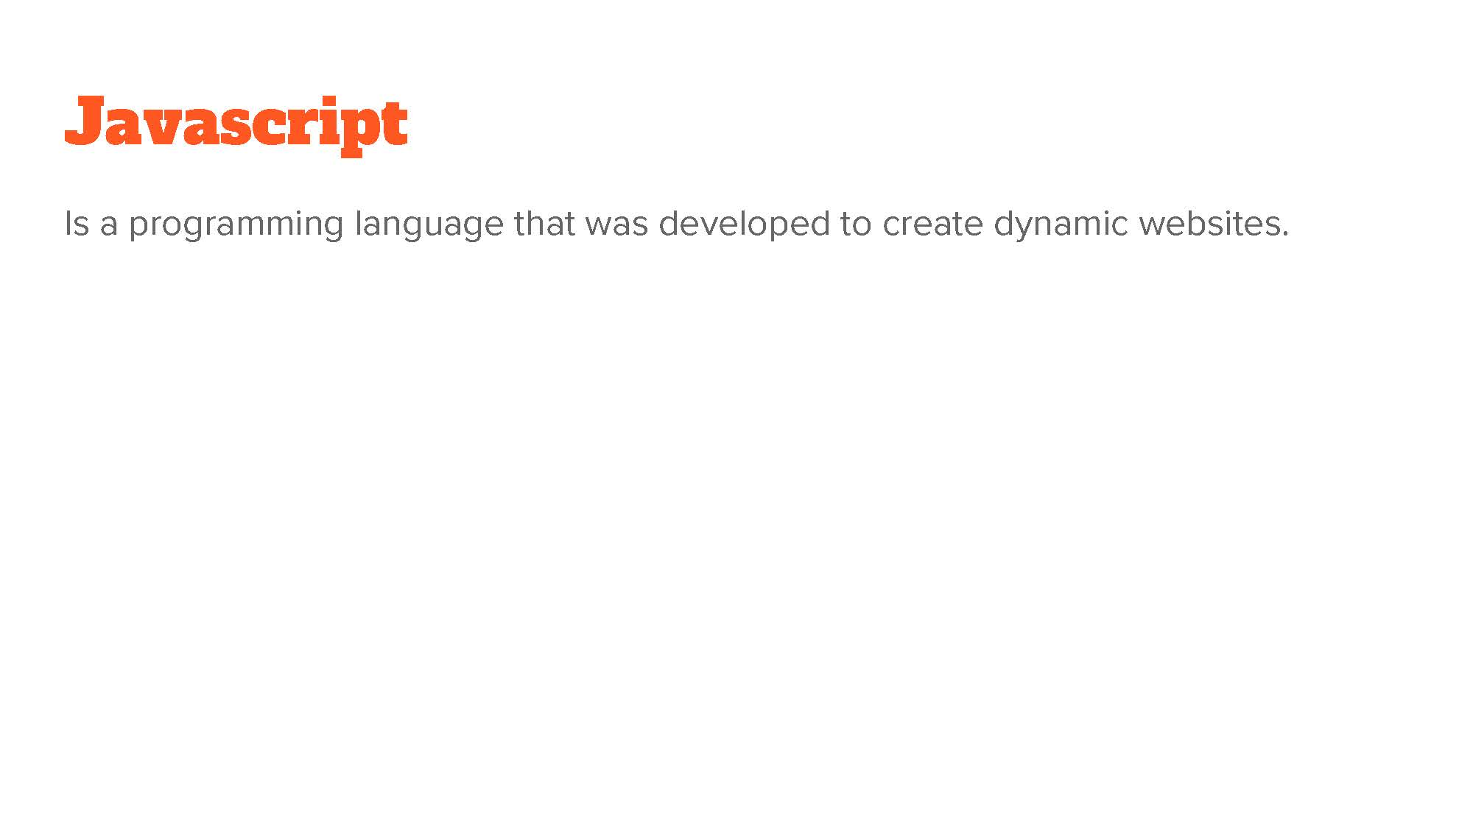

Slide 24
JS Textbook Resources for Free
One of many free resources online for people learning Javascript.
https://eloquentjavascript.net/
You don’t know JS (More advanced topics)
https://github.com/getify/You-Dont-Know-JS
And for those of you who can’t get enough:
https://jsbooks.revolunet.com/

